Slide 1

Understanding and Dealing with Hard Faults in Persistent Memory Systems
Brian Choi, Randal Burns, Ryan Huang
EuroSys ‘21

Slide 2
Summary
We introduce a new class of faults in PM systems: Soft-to-Hard Faults
In-depth study: 28 real-world examples in 7 PM systems
Solution: Arthas, tool to recover PM systems that suffer from Soft-to-Hard Faults to a correct working state
minimal data loss
Notes:
Revise to be more concise

Slide 3
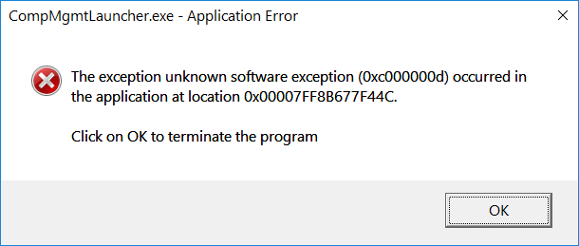
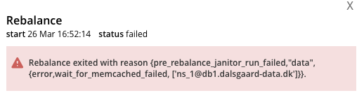

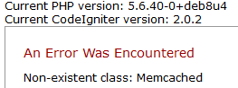
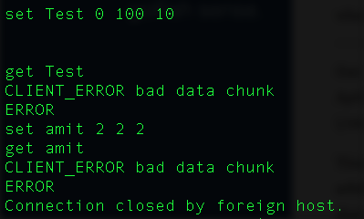

Errors Frequently Occur in Systems

Slide 4



First Thing to Try? Restart!

Slide 5
Soft and Hard Faults
“Soft” faults -> Restart fixes the system
Bad volatile states: go away upon restart
Many production failures are soft/transient (Gray, 1985)
“Hard” faults -> Faults are recurring even after restart
Bad states written to storage (ie. disk) permanently exist after restart

Slide 6
Soft and Hard Faults
“Soft” faults -> Restart fixes the system
Bad volatile states: go away upon restart
Many production failures are soft/transient (Gray, 1985)
“Hard” faults -> Faults are recurring even after restart
Bad states written to storage (ie. disk) permanently exist after restart
Hard faults are particularly prominent in persistent memory
Introduces new hard faults in your system
Restart not effective anymore!!

Slide 7

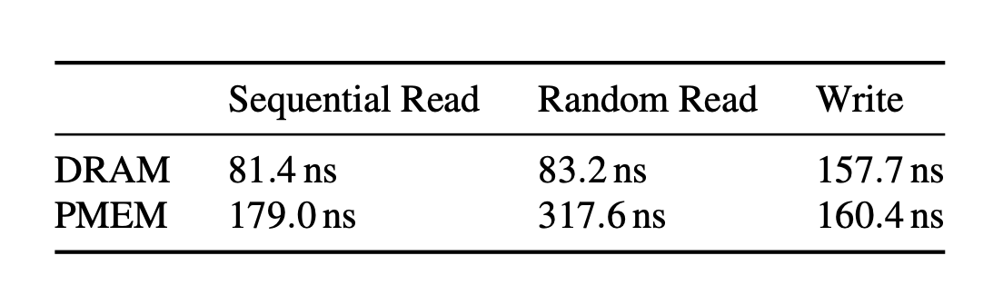
Persistent Memory = More Options
Fast new storage technology called Persistent Memory (PM)
Latency comparable to DRAM
Persistently store data
Developers now have more options to persist data
PM much faster than previous storage
More states become persistent (ie. cache)

Slide 8





Soft-to-Hard Faults
PM persists many states
“Soft” states move to PM more frequently, become “hard” states
Restart can’t fix any issues with these “Soft-to-Hard” states
Memory Cleaned up
Soft Good States in Volatile Memory
after Restart
Memory Leaks
Traditional,
Disk-based
Indexing Structures
Restart
Memory Leaks
PM Integration
Hard States in Persistent Memory
Soft Bad States in Volatile Memory

Slide 9

A Real Soft-to-Hard Fault
Memory
Soft Fault in Memcached
Item
refcount
h_next
val
Items and client connection data all in volatile memory
Item
refcount
h_next
val
.
.
.
Two bad states: refcount and h_next corrupted
Client Connection Data
Original Memcached
https://github.com/memcached/memcached/issues/271
Notes:
Use complicated Memcached example:
traditional Memcached doesn’t have a simple persistence model (extstore - external storage for when you have really large values)
the Memcached refcount bug is complicated to understand
Use a simple Redis example:
Several efforts to make Persistent Memcached: choose to make hashtable persistent/item persistent
Get advantage. but consequence of porting this leads to bug.
Too detailed:
want to give an example to give anchor but too detailed. More concise:
12 minute version: use real example instead of conceptual hashtable example as driving example for the talk.
20 minute version: show both

Slide 10
A Real Soft-to-Hard Fault
Traditional, Disk-based System
Memory
Memory
Item
refcount
h_next
val
Item
refcount
h_next
val
Restart
Item
refcount
h_next
val
Item
refcount
h_next
val
.
.
.
.
.
.
CCD
CCD
The two bad soft states go away after restart
Original Memcached
Notes:
Use complicated Memcached example:
traditional Memcached doesn’t have a simple persistence model (extstore - external storage for when you have really large values)
the Memcached refcount bug is complicated to understand
Use a simple Redis example:
Several efforts to make Persistent Memcached: choose to make hashtable persistent/item persistent
Get advantage. but consequence of porting this leads to bug.
Too detailed:
want to give an example to give anchor but too detailed. More concise:
12 minute version: use real example instead of conceptual hashtable example as driving example for the talk.
20 minute version: show both

Slide 11
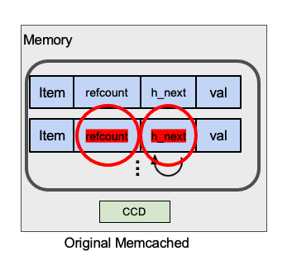
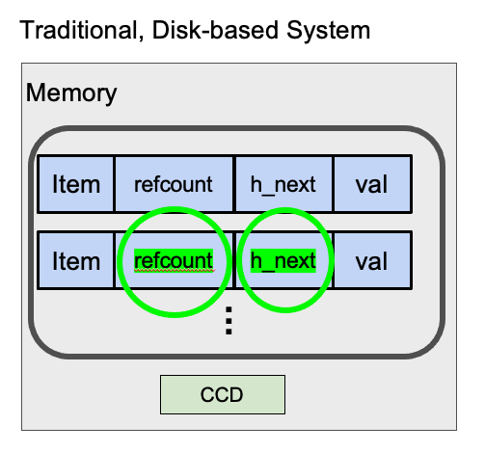
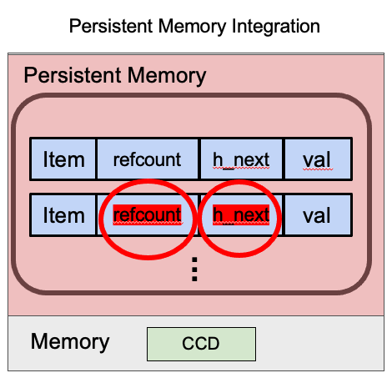
A Real Soft-to-Hard Fault
Restart
Restart
Notes:
Use complicated Memcached example:
traditional Memcached doesn’t have a simple persistence model (extstore - external storage for when you have really large values)
the Memcached refcount bug is complicated to understand
Use a simple Redis example:
Several efforts to make Persistent Memcached: choose to make hashtable persistent/item persistent
Get advantage. but consequence of porting this leads to bug.
Too detailed:
want to give an example to give anchor but too detailed. More concise:
12 minute version: use real example instead of conceptual hashtable example as driving example for the talk.
20 minute version: show both

Slide 12
Our Contributions
Hard Fault Study where we examine 28 real-world bugs in PM systems and analyze the bugs.
Arthas: tool to recover PM systems that suffer from Soft-to-Hard Faults
Dependency-based rollback - minimize data loss
Static Analysis - to aid dependency formulation

Slide 13
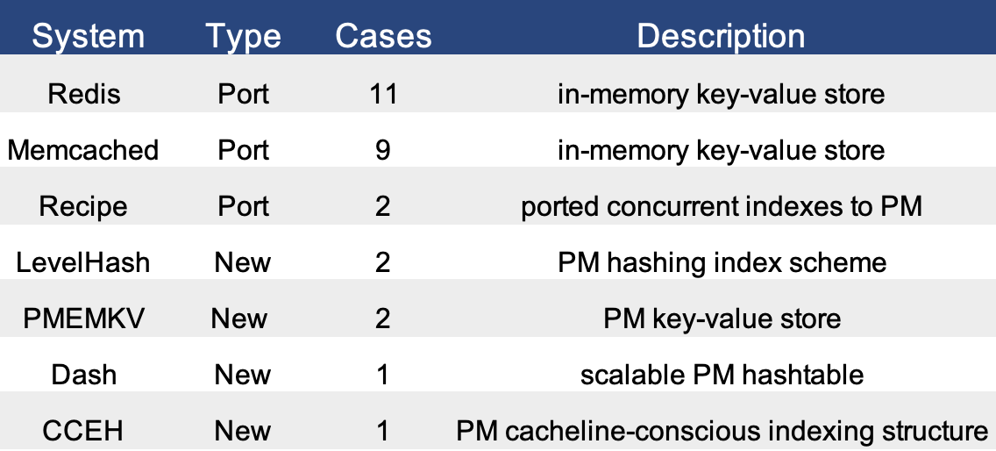
Hard Fault Study
We found 28 bugs from 7 PM systems that demonstrate the soft-to-hard fault problem.

Slide 14
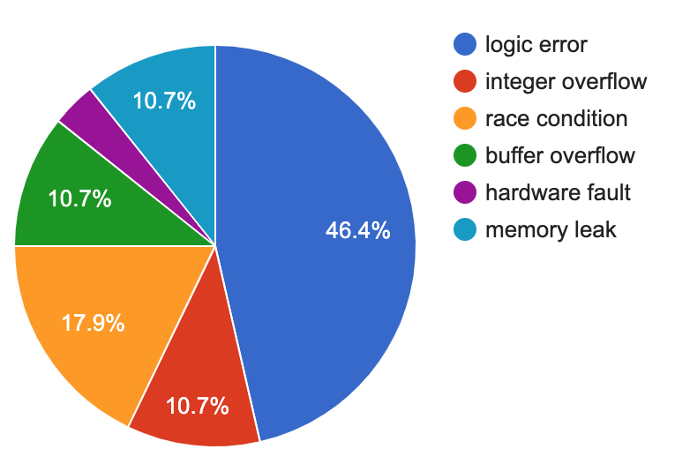
Finding 1: Root Causes Are Diverse
3.6%
Root Cause Distribution
PM Hard Faults can be caused by many different types of root causes
Logic Errors are most prevalent (46%), but other types of root causes are relatively evenly distributed
Notes:
Redraw figures

Slide 15
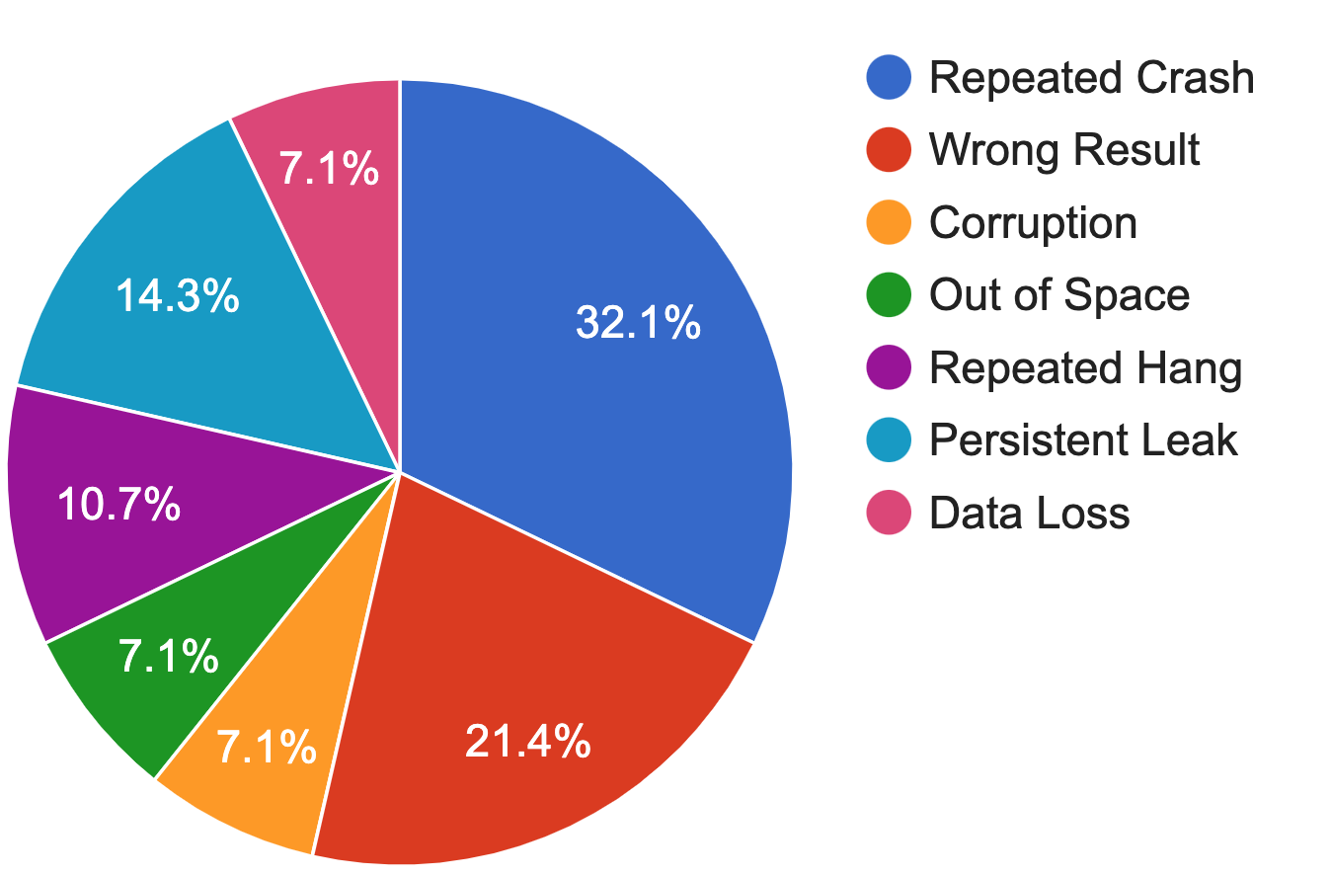
Finding 2: Consequences Are Severe
Consequence Distribution
PM Hard Faults cause severe problems, such as repeated crashes and wrong results, not just minor issues

Slide 16
Finding 3: Over Half Propagate Bad State
Type I: PM variable has a bad value that directly causes the problem
Type II: PM variable has a bad value that propagates bad state and indirectly causes the problem
Type | Distribution
Type I (direct) | 18%
Type II (indirect propagation) | 68%
Type III (miscellaneous) | 14%
Type Distribution of Cases
68% of the bugs propagate bad state among volatile and persistent variables throughout the system

Slide 17
PM Hard Faults Lead to Bad State
PM hard faults are a diverse set of bugs
Challenging to statically find all bugs with one solution
Insight: At runtime, PM hard faults eventually cause bad state to be persisted
Revert bad states to good states
Integer Overflow
.
Memory Leak
.
Logic Error
.
Bad state eventually gets persisted
Notes:
actually include paper’s insights to revert bad states to only revert bad states while minimizing data loss.
analyzer + reactor to minimize data loss.
Summarize insight from paper but into box, motivate how we design the solution.

Slide 18




We Must Revert the Root Cause
68% of the bugs propagate bad state
Design Principle: Even when one bad PM state is rolled back, the PM system could still quickly hit the same failure if the root cause of the bad state is not reverted.
bad state
crash
good state
revert bad state
reoccurs
restart system
Notes:
actually include paper’s insights to revert bad states to only revert bad states while minimizing data loss.
analyzer + reactor to minimize data loss.
Summarize insight from paper but into box, motivate how we design the solution.

Slide 19
How to Revert Bad States?
Goal of effective mitigation: hard fault disappears and doesn’t reappear again
Rollback bad states to a previous, older version that is a good state
Checkpoint data: we keep multiple versions of state
Revert all propagated bad states including the root cause

Slide 20
Standard Checkpoint/Rollback
time:t
{
{key1: value1},
{key2: value2}
}
SNAPSHOT

Slide 21
Standard Checkpoint/Rollback
time:t
time:t+n
{
{key1: value1},
{key2: value2}
}
{
{key1: value1},
{key2: value2},
{key3: value3},
{key4: value4},
{key10000: ERROR},
{key10001: value6},
}
.
.
SNAPSHOT
.
crash

Slide 22
Standard Checkpoint/Rollback
time:t
time:t+n
{
{key1: value1},
{key2: value2}
}
{
{key1: value1},
{key2: value2},
{key3: value3},
{key4: value4},
{key10000: ERROR},
{key10001: value6},
}
.
.
SNAPSHOT
.
root cause
crash

Slide 23
Standard Checkpoint/Rollback
time:t
time:t+n
time:t+n+1
{
{key1: value1},
{key2: value2}
}
{
{key1: value1},
{key2: value2},
{key3: value3},
{key4: value4},
{key10000: ERROR},
{key10001: value6},
}
{
{key1: value1},
{key2: value2}
}
Rollback
.
.
.
SNAPSHOT
SNAPSHOT
crash
root cause
Loses keys 3 to 10,001 when only key 10,000 was a bad state

Slide 24
Standard Checkpoint/Rollback
time:t
time:t+n
time:t+n+1
{
{key1: value1},
{key2: value2}
}
{
{key1: value1},
{key2: value2},
{key3: value3},
{key4: value4},
{key10000: ERROR},
{key10001: value6},
}
Standard Checkpointing loses an unnecessary amount of data
{
{key1: value1},
{key2: value2}
}
Rollback
.
.
.
SNAPSHOT
SNAPSHOT
crash
root cause
Loses keys 3 to 10,001 when only key 10,000 was a bad state

Slide 25
Design Goal - Minimal Data Loss
Standard Checkpointing approaches lose too much data
Design Principle: Use static analysis on PM system to find dependencies of the bad PM variables and revert only the bad PM states using these dependencies
{
{key1: value1},
{key2: value2},
{key3: value3},
{key4: value4},
{key10000: ERROR},
{key10001: value6},
}
{
{key1: value1},
{key2: value2},
{key3: value3},
{key4: value4},
{key10001: value6},
}
Use Static Analysis
.
.
.
.
.
.
root cause
crash

Slide 26
Arthas: Overview
Arthas: tool that recovers PM systems from PM hard faults
Techniques
Checkpoint old versions
Static analysis and dynamic tracing
Dependency-based rollback
Goals
Recover PM system quickly
Minimize data loss
Small runtime overhead

Slide 27


Arthas Workflow
Checkpoint Library
PM System Code
Instrumented PM System
Detector
Reactor
Program Dependency Graph
Arthas Analyzer
PM Checkpoint File
Notes:
what is overall design goal? low overhead, data loss.
talk about design goals before overview slide.

Slide 28
Checkpoint Library
Checkpoint multiple versions of PM state to later revert
Implementation: Intercepts PM framework API calls
Global sequence numbers assigned to each PM update
ensure order when reverting
pmem_ptr = pmem_alloc();
cp_entry
0xf4a000
data
sequence num
sizes

Slide 29
Checkpoint Library
Checkpoint multiple versions of PM state to later revert
Implementation: Intercepts PM framework API calls
Global sequence numbers assigned to each PM update
ensure order when reverting
*pmem_ptr = 7;
pmem_flush(pmem_ptr, sizeof(int));
pmem_ptr = pmem_alloc();
cp_entry
0xf4a000
data
cp_entry
0xf4a000
data
7
sequence num
sequence num
1
sizes
sizes
4

Slide 30
Checkpoint Library
Checkpoint multiple versions of PM state to later revert
Implementation: Intercepts PM framework API calls
Global sequence numbers assigned to each PM update
ensure order when reverting
*pmem_ptr = 7;
pmem_flush(pmem_ptr, sizeof(int));
*pmem_ptr = 4;
pmem_flush(pmem_ptr, sizeof(int));
pmem_ptr = pmem_alloc();
cp_entry
0xf4a000
data
cp_entry
0xf4a000
data
7
cp_entry
0xf4a000
data
7
4
sequence num
sequence num
1
sequence num
1
2
sizes
sizes
4
sizes
4
4

Slide 31
Analyzer: Dependency-based Rollback
Dependency-based Rollback: More targeted reversion
Use dependencies to only revert necessary bad states.
Program Dependency Graph of PM System
Fault instruction -> starting point of dependency analysis
Slice: see what instructions influence this fault

Slide 32
Analyzer: Dependency-based Rollback
This is the Persistent Memory Write Timeline of a PM system
a = 3;
volatile write
x = -5;
PM write
b = 7;
dependency
y = x+5;
z = 2/y;

Slide 33
Analyzer: Dependency-based Rollback
Crash at z, root cause due to x = -5;
a = 3;
volatile write
x = -5;
root cause
PM write
b = 7;
dependency
y = x+5;
z = 2/y;
crash

Slide 34
Arthas Analyzer: Slicing
Slice: to preserve data dependencies during reversion
Slice:
a = 3;
x =-5;
root cause
x = -5;
b = 7;
y = x+5;
y = x+5;
z = 2/y;
crash
z = 2/y;

Slide 35
Arthas Analyzer: Purge Mode
Minimizes data loss, but may not lead to a perfectly consistent system
Slice:
a = 3;
Revert
root cause
x = -5;
x = -5;
b = 7;
Revert
y = x+5;
y = x+5;
Revert
z = 2/y;
crash
z = 2/y;

Slide 36
Arthas Analyzer: Rollback Mode
More conservative approach: reverts between dependent updates
Captures dependencies of the system
Slice:
a = 3;
Revert
x = -5;
x = -5;
root cause
b = 7;
Revert
y = x+5;
y = x+5;
Revert
z = 2/y;
crash
z = 2/y;

Slide 37

Evaluation
One 8-core CPU (2.50GHz) and two 128 GB Intel Optane DC Persistent Memory DIMMs.
We test on 12 bugs both from our study and other existing bugs
We run Arthas against two baselines
pmCRIU: A state-of-the-art checkpoint and rollback system
ArCkpt: Alternate version of Arthas that reverts without the analyzer component, time-based
Notes:
Add table of systems
Move baselines to separate slides.

Slide 38
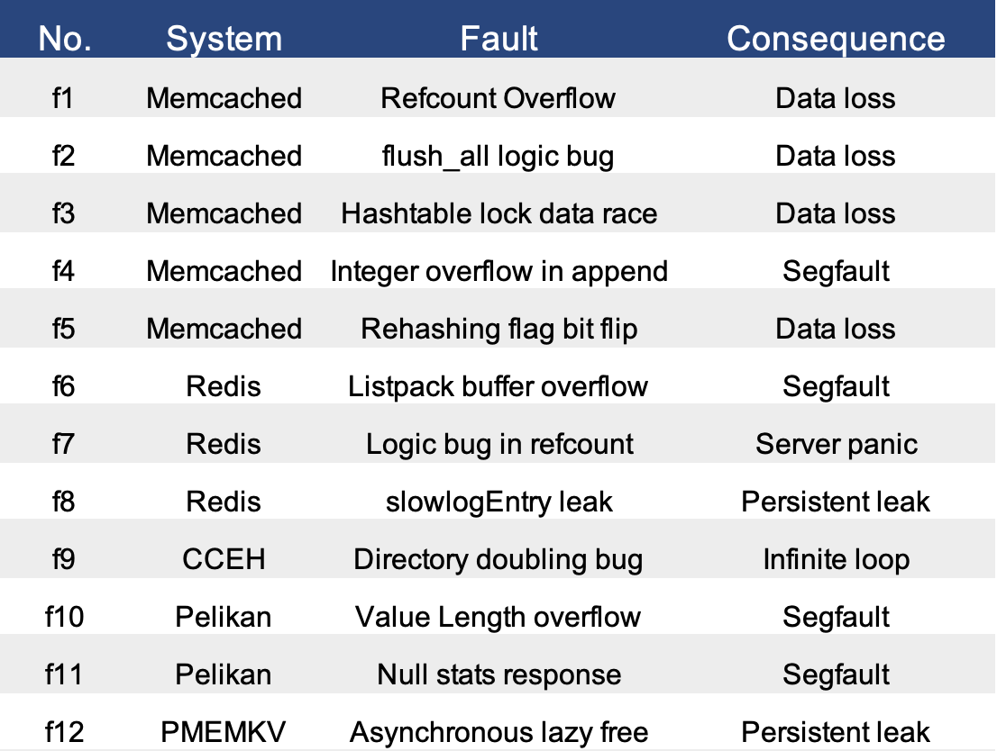
12 Real-World Bugs
We evaluate on a diverse set of bugs with varying consequences

Slide 39
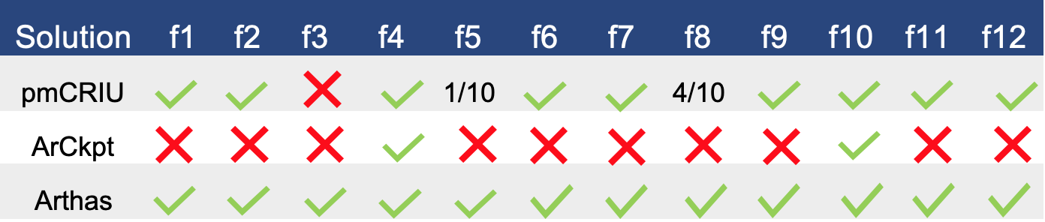
Effectiveness
Arthas is able to resolve 12 out of the 12 bugs
ArCkpt suffers from timeouts: 2 out of the 12 bugs
pmCRIU is only able to reliably mitigate 9 out of the 12 bugs.
Notes:
Red box around bottom row, explain results (numbers)?
Green checks, red X’s blue box around Arthas.
1/10 in orange
Or get rid of table
equally important is the data loss aspect.

Slide 40
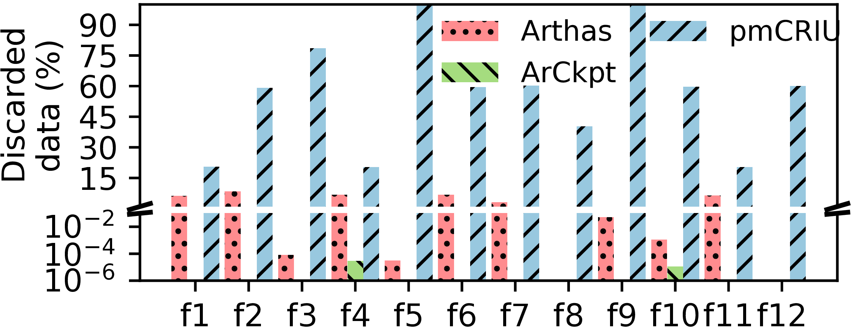
Data Discarded by Solutions
Arthas discards 10x less data than pmCRIU

Slide 41
Recovery Time
Arthas is slightly slower, but is still in an acceptable range of approximately one minute more than pmCRIU while also minimizing data loss.
Notes:
Overall, performance is acceptable as we bring system to a good state. compared to fast baseline that loses most data.

Slide 42
Conclusion
Soft-to-Hard Faults are an underexplored, yet significant problem for new PM systems.
Arthas reliably detects and mitigates Hard Faults in PM systems
Dependency-based rollback - minimize data loss
Mitigate 12 Hard Faults from 5 PM systems with 10x less data loss than pmCRIU with a reasonable performance overhead.
Our tool is publicly available at https://github.com/OrderLab/Arthas
Notes:
Link to our tool: arthas open source github
Related works slide: before conclusion. list different works + differences from our work in what way.

